Slide 1
How to load GIFs
<!-- <span> <img src="/progress_pics/playerAttackTest2.gif" width="300" height="300" style="display:inline-block; vertical-align: middle;" /> </span> -->

Slide 2
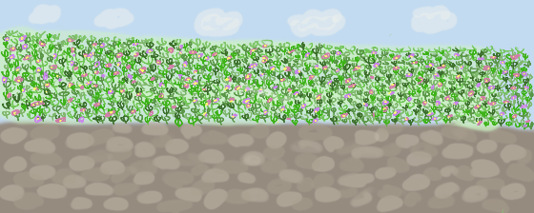
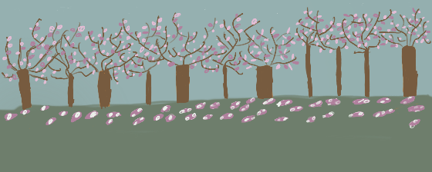

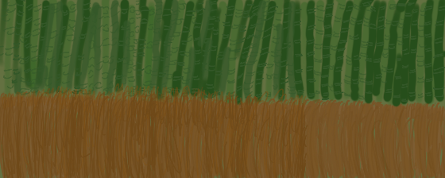
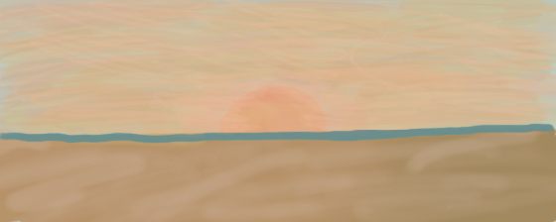
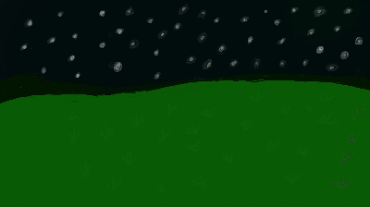
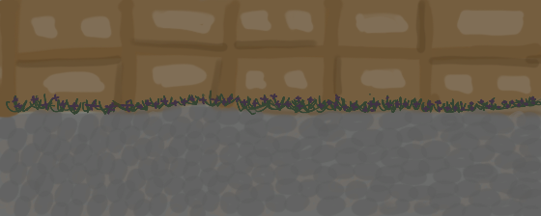
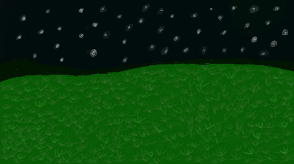
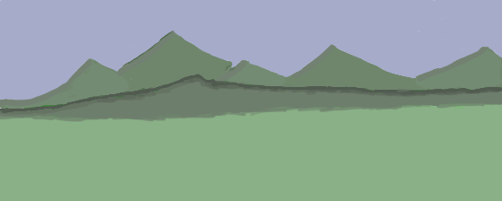

Slide 3
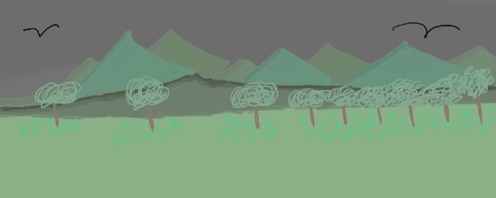
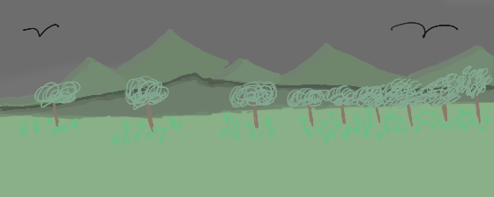
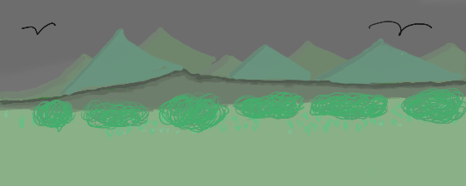
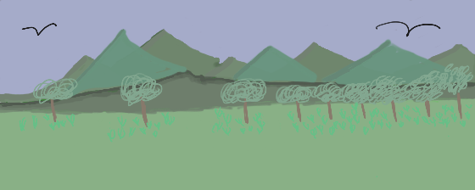
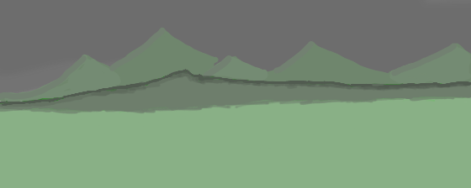
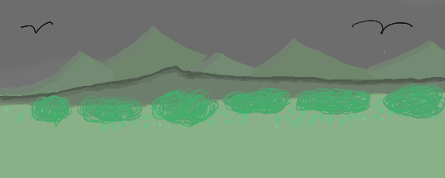
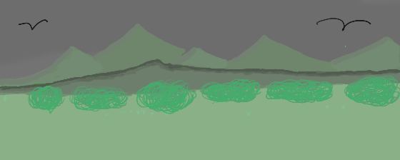
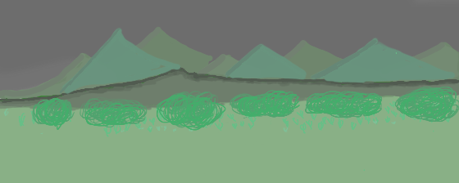
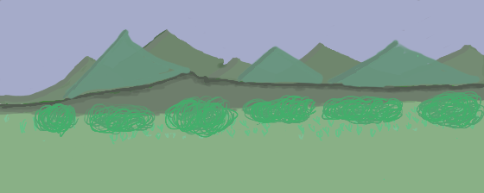
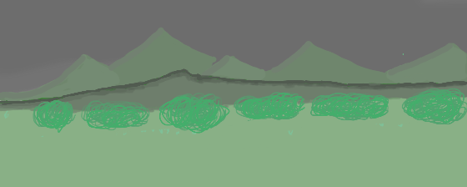
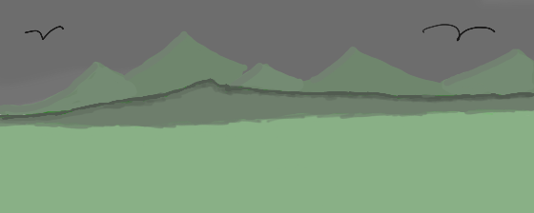


Slide 4
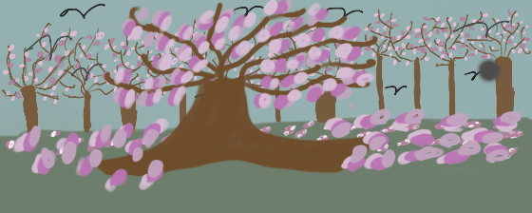
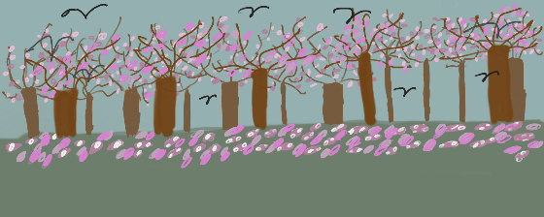
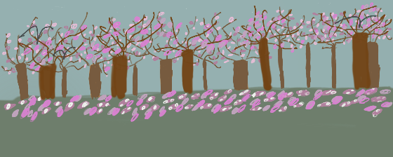
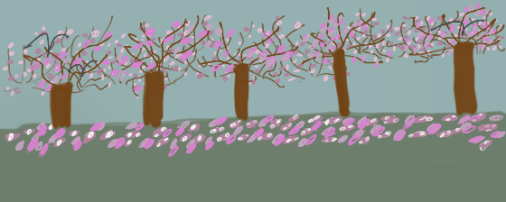
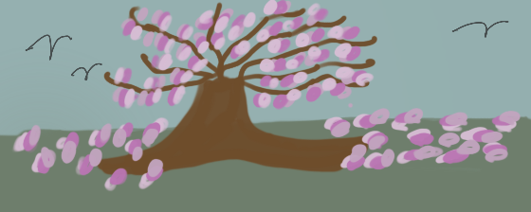
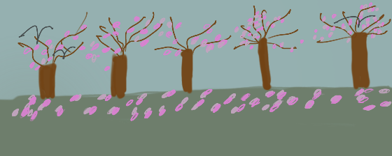
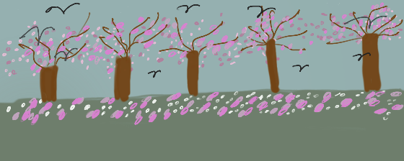
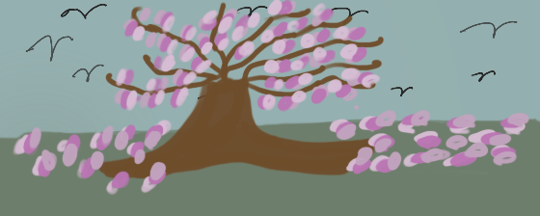
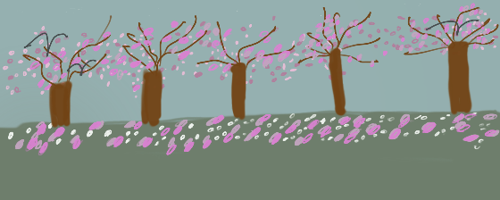

Slide 5

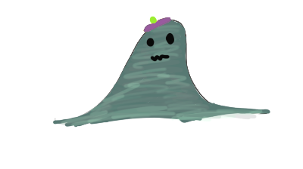

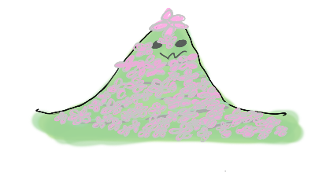

Slide 6
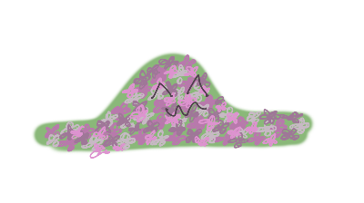
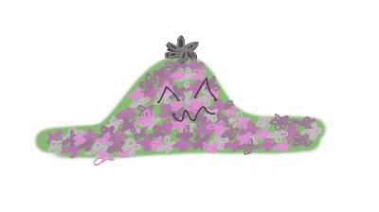

Slide 7



Option 1
Option 2
Option 3

Slide 8


Slide 9
PLAYER

Slide 10





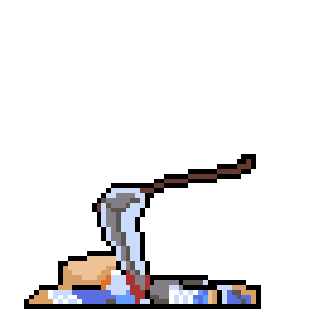
Running
Jump
Land
Idle
Hurt
Dead

Slide 11
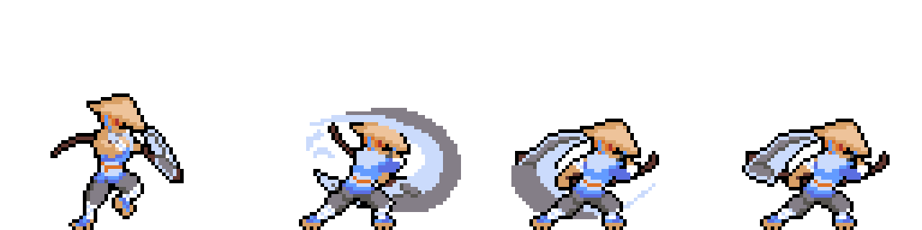
Attack

Slide 12
Notes:
Player Running

Slide 13
Notes:
Player Land

Slide 14
Notes:
Player Jump

Slide 15
Notes:
Player Idle

Slide 16
Notes:
Player Hurt

Slide 17
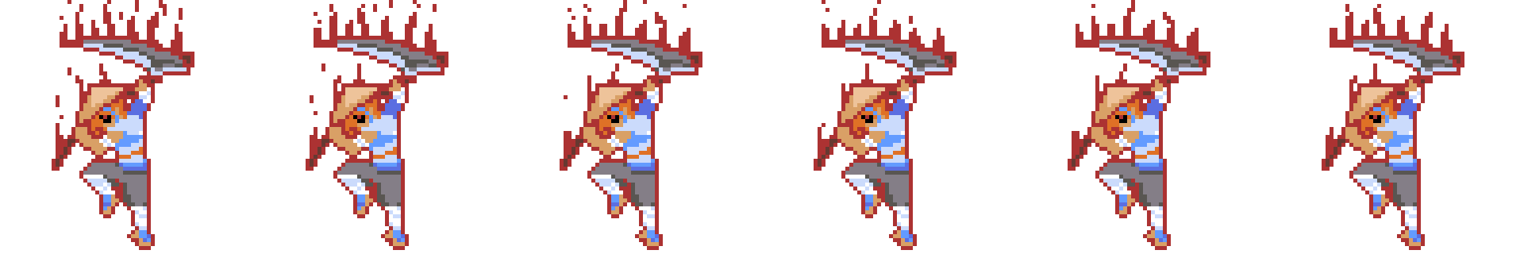

Flow State Activate
Flow State

Slide 18
Notes:
Player Flow

Slide 19
Notes:
Player Flow State Activate

Slide 20
Notes:
Player Dead

Slide 21
Notes:
Player Attack

Slide 22
Enemy

Slide 23
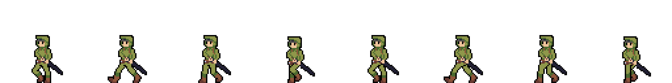
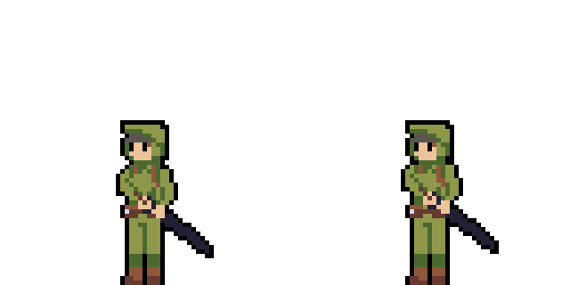
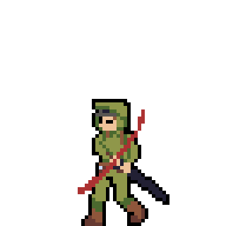

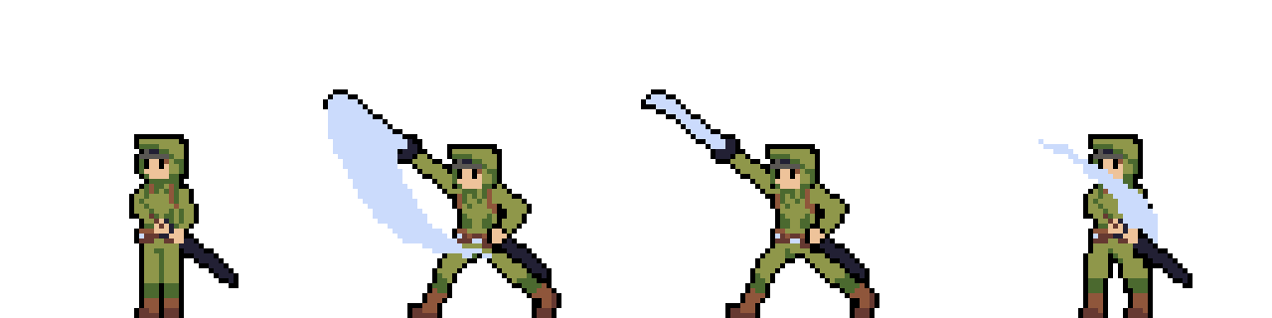
Walking
Idle
Hurt
Dead
Attack

Slide 24
Notes:
Enemy Walk

Slide 25
Notes:
Enemy idle

Slide 26
Notes:
Enemy hurt

Slide 27
Notes:
Enemy dead

Slide 28
Notes:
Enemy Atttack

Slide 29



Mountains
Sky
Cherry Blossoms

Slide 30



Fire on Right of Flow Bar
Flow Bar
Flow State Activate

Slide 31
Reap
Kurt Kimura, Amanda Nitta, Lloyd Sanderson
https://ics485-project-reap.github.io/

